Slide 1

Serenity Prayer
God, grant me the serenity to accept
the things I cannot change,
the courage to change the things I can,
and the wisdom to know the difference

Slide 2
The Twelve Steps of Nar-Anon Family Groups
We admitted we were powerless over the addict – that our lives had become unmanageable
Came to believe that a Power greater than ourselves could restore us to sanity.
Made a decision to turn our will and our lives over to the care of God as we understood Him.
Made a searching and fearless moral inventory of ourselves.
Admitted to God, to ourselves, and to another human being the exact nature of our wrongs.
Were entirely ready to have God remove all these defects of character.
Humbly asked Him to remove our shortcomings.
Made a list of all persons we had harmed and became willing to make amends to them all.
Made direct amends to such people wherever possible except when to do so would injure them or others.
Continued to take personal inventory and when we were wrong promptly admitted it.
Sought through prayer and meditation to improve our conscious contact with God as we understood Him, praying only for knowledge of His will for us and the power to carry it out.
Having had a spiritual awakening as a result of these steps, we tried to carry this message to others, and to practice these principles in all our affairs.

Slide 3
The Twelve Traditions of Nar-Anon Family Groups
Our group experience suggests that the unity of the Nar-Anon Family Groups depends upon our adherence to these traditions.
Our common welfare should come first; personal progress for the greatest number depends on unity.
For our group purposes there is but one authority – a loving God as He may express Himself in our group conscience. Our leaders are but trusted servants – they do not govern.
The relatives of addicts, when gathered for mutual aid, may call themselves a Nar-Anon Family Group, provided that as a group, they have no other affiliation. The only requirement for membership is that there be a problem of addiction in a relative or friend.
Each group should be autonomous except in matters affecting other Nar-Anon Family Groups, or NA as a whole.
Each Nar-Anon Family Group has but one purpose; to help families of addicts. We do this by practicing the Twelve Steps of Nar-Anon, by encouraging and understanding our addicted relatives, and by welcoming and giving comfort to families of addicts.
Our Family Groups ought never to endorse, finance or lend our name to any outside enterprise, lest problems of money, property and prestige divert us from our primary spiritual aim; but although a separate entity, we should always cooperate with Narcotics Anonymous.
Every group ought to be fully self-supporting, declining outside contributions.
(Continued)

Slide 4
The Twelve Traditions of Nar-Anon - continued
Nar-Anon Twelfth Step work should remain forever non-professional, but our service centers may employ special workers.
Our groups, as such ought never to be organized, but we may create service boards or committees directly responsible to those they serve.
The Nar-Anon Family Groups have no opinion on outside issues; hence our name ought never be drawn into public controversy.
Our public relations policy is based on attraction rather than promotion; we need always maintain personal anonymity at the level of press, radio, films, internet, and other forms of mass media. We need guard with special care the anonymity of all NA members.
Anonymity is the spiritual foundation of all our traditions, ever reminding us to place principles above personalities.

Slide 5
Mission Statement
The Nar-Anon Family Groups are a worldwide fellowship for those affected by someone else’s addiction. As a twelve step program, we offer our help by sharing our experience, strength, and hope.
Vision Statement
We will carry the message of hope throughout the world to those affected by the addiction of someone near to them.
We will do this by
letting them know they are no longer alone;
practicing the Twelve Steps of Nar-Anon;
encouraging growth through service;
making information available through outreach encompassing public information, hospitals, institutions, and websites; and
changing our own attitudes.

Slide 6
The Family
Addiction is a family disease. It affects the relationships of those close to the addict: parents, spouse, siblings, children, long-time friends, and employers. We who care the most suffer from the addict’s erratic behavior. We try to control and are ashamed of the scenes caused. Soon, we begin to think we are to blame and assume the guilt, fears and responsibilities of the addict. Thus, we become sick, too.
It is painful to watch our loved ones slowly kill themselves with drugs. We see them deteriorate before our eyes and are powerless to stop them. If the addicts are spouses, we may watch as our finances slip down the drain. When the addicts are our children, all the hopes and dreams we may have for them begin to fade. When the addicts are our parents, we may never have had a childhood because we assumed parental responsibilities at an early age. We may cover up for addicted sibling, friends, and employees; we may blame them or may excuse their unacceptable behavior. We worry, we take on their responsibilities, we make excuses, and we try to cover up for them. This is our anxiety, and as a result, we become enablers.
(Continued)

Slide 7
The Family continued
The obsession of the family becomes apparent when we try to control the addicts’ using. We become detectives and search the premises and their personal belongings for drugs and drug-related items. We become obsessed with where they are, what they are doing, and how we might control their addiction. We want to believe the problem can solve itself even though our gut feeling tells us this is not so. We want to believe the addicts’ promises, but common sense tells us there is something wrong. We become victims of denial. In our despair, we have searched for an answer. We have come to Nar-Anon because we are burdened with responsibilities and feel we are alone. We come here to change the behavior of the addicts, but soon find our own thinking and attitude must change if we are to feel relief. We find people in Nar-Anon who understand what we are going through and are ready to share their experience, strength, and hope to help us. In Nar-Anon, we learn how to live one day at a time; we stop projecting. We learn how to deal with our feelings of fear, guilt, obsession, anxiety, and denial. We look at ourselves and put our energy where we have some power over the choices in our own lives.

Slide 8
Changing Ourselves
Addiction is like a chain reaction. It is a disease which affects the addict as well as family members, friends, and co-workers. We try to control, cover up, and take on the responsibilities of the addict. The sickness spreads to those of us who care the most. Eventually, we begin to feel used and unhappy. We worry, lose trust, and become angry. The addict blames us and we feel guilty. If only something or someone would change!
When we discover Nar-Anon, we find others with the same feelings and problems. We learn we can neither control addicts nor change them. We have become so addicted to the addict that it is difficult to shift the focus back to ourselves. We find we must let go and turn to faith in a Higher Power. By working the steps, following the traditions and using the tools of the program, we begin, with the love and help of our Higher Power and others, to change ourselves.
As we reach out for help, we become ready to reach out a helping hand and heart to those in need of Nar-Anon. We understand. We do recover. Slowly, new persons emerge. Change is taking place.

Slide 9
About Addiction
We have learned that addiction is an illness. It is a physical, mental, and spiritual disease that affects every area of life. It can be arrested, but never cured. We have found that compulsive use of drugs does not indicate a lack of affection for the family. It is not a matter of love, but of illness. The addict’s inability to control their use of drugs is a symptom of the disease of addiction. Even when they know what will happen when they take the first drink, pill, or fix, they are likely to do so. This is the insanity we speak of in regard to this disease. Only complete abstinence from the use of drugs, including alcohol, can arrest this disease. No one can prevent the addicts’ use of drugs. When we accept that addiction is a disease, and that we are powerless over it, we become ready to learn a better way to live.

Slide 10
Keeping Our Meetings Healthy
To ensure the success of our meetings in solving our common problems, we must recognize and avoid three destructive forces that can create dissension and ultimately destroy the group.
The first destructive force is the discussion of any religious denomination.
Addiction respects no particular religion; therefore, our program must be designed to help us regardless of our various beliefs. Let us not defeat our purpose by discussing any particular denomination.
The second destructive force is gossip.
We are here to help ourselves and others by sharing our experience, strength, and hope while keeping the focus on ourselves. Gossip about others, including the addict, will defeat our purpose. We know that nobody wants to deliberately tear down the group or its principles.
The third destructive force is dictatorship.
Our leaders are but trusted servants – they do not govern. We do not give advice, we suggest by telling how we solved similar problems through our experiences.
With the guidance of the Twelve Traditions and Twelve Concepts of Service, the very essence of Nar-Anon is that the whole program as it relates to your personal recovery is merely suggested.
(Continued)

Slide 11
Keeping Our Meetings Healthy – continued
We have no creed, charges, obligations, nor anything that would tend to hinder you; your progress can be made in your own time and in your own way. We merely invite your attendance in a common cause.
An important tool in our meetings is Nar-Anon conference approved literature (CAL). Written by and for our fellowship, and approved at our World Service Conference, it is an expression of Nar-Anon principles and the experience, strength and hope or our members. Using CAL ensures members are hearing the same message no matter where they attend a meeting. This unites our members and avoids affiliation with outside causes in accordance with our traditions.
“To watch is not to love” - Jung

Slide 12
Helping
Our role as helper is not to do things for those we are helping, but to be things, not to try to train and change their actions, but to train and change our reactions. We can change our negatives to positives:
fear to faith
contempt for what they do to respect for the potential within them;
rejection to release with love;
not try to make them fit a standard or image, nor expect them to measure up to or down from that standard, but give them an opportunity to develop the best within them, regardless of what that best may be;
dominance to encouragement
panic to serenity
false hope, self-centered, to real hope, God-centered;
the rebellion of despair to the energy of personal revolution;
driving to guidance; and
self-justification to self-understanding.
As we change in such ways as these, we change the world about us and all the people in our world for the better.
Self-pity blocks effective action. The more we indulge in it the more we feel that the answer to problems is a change in others or the world, not a change in us. Thus, we become a hopeless case.
(continued)

Slide 13
Helping – continued
Exhaustion is the result when we use energy in mulling over the past with regret, or in trying to figure ways to escape a future that hasn’t even come yet. Likewise, setting up an image of the future and anxiously hovering over it for fear that it will or won’t come true, uses all of our energy and leaves us unable to live today. Yet living this day is the only way to have a life.
Take no thought for the future actions of others, neither expecting them to be better nor worse as time goes on. For in such expectations, we are really trying to create. This is God’s job, not ours. Love and let be.
Remember all people are always changing. When we judge them, we judge on what we believe we know of them, failing to realize that there is much we do not know, and that they are constantly changing as they try for better or worse to cope with life. Give others credit even as all of us struggle; give them credit for attempts at progress, even if their changes are not apparent, and above all give them credit for having had many victories which are unknown. We are all of the same cloth, though of a different cut.
Remember we too are always changing, and we can direct that change consciously if we so desire. Ourselves we can change. Others we can only love.

Slide 14
Just for Today
Just for today I will try to live through this day only, and not tackle my whole life problem at once. I can do something for twelve hours that would appall me if I felt I had to keep it up for a lifetime.
Just for today I will be happy. This assumes to be true what Abraham Lincoln said, “Most people are as happy as they make up their minds to be.”
Just for today I will adjust myself to what is, and not try to adjust everything to my own desires. I will take my luck as it comes, and fit myself to it.
Just for today I will try to strengthen my mind. I will study. I will learn something useful. I will not be a mental loafer. I will read something that requires effort, thought, and concentration.
Just for today I will exercise my soul in three ways. I will do somebody a good turn and not get found out; if anybody knows of it, it will not count. I will do at least two things I don’t want to do – just for exercise. I will not show anyone that my feelings are hurt; they may be hurt, but today I will not show it.
Just for today I will be agreeable. I will look as well as I can, dress becomingly, talk low, act courteously, criticize not one bit, not find fault with anything, and not try to improve or regulate anybody but myself.
Just for today I will have a program. I may not follow it exactly, but I will have it. I will save myself from two pests, hurry and indecision.
Just for today I will have a quiet half hour all by myself and relax. During this half hour, sometime, I will try to get a better perspective of my life.
Just for today I will be unafraid. Especially, I will not be afraid to enjoy what is beautiful and to believe that as I give to the world, so the world will give to me.

Slide 15
We’ve Been There
Welcome, we are glad you found us. You may be here because you are desperately seeking help for your addicted loved one. Maybe they attended treatment, and it was suggested you attend a Nar-Anon meeting. The addict may be incarcerated, facing legal problems, or about to lose custody of their children. They may not come home for days at a time. Aspects of your life may have become unmanageable: finances, health, and spiritual or moral beliefs.
Whatever the case may be, we too have traveled this path and know your deep sense of desperation and need for relief. How you are related to the addict, their drug of choice, the treatment center they attended, or if they didn’t attend at all, is not our focus. We are here to offer you our experience, strength, and hope. We will share what brought us back from the brink of insanity. We too have been where you are now. We do not offer advice; we listen and share how we have solved similar problems.
We offer you the opportunity to tell us briefly why you are here, keeping the addict and their situation anonymous. As you listen to others, you may find tools here to help you. We found that keeping an open mind and applying the principles of this program to our lives helped us change. For matters you want to keep private, we suggest you find a sponsor with whom you can be more open and honest. It is suggested you attend at least six meetings before deciding if this program is right for you. We continue to attend meetings to offer you what we were so freely given. This program may not be what you expected, but attending Nar-Anon can be a life changing experience.

Slide 16




TO PURCHASE LITERATURE
https://nar-anon-webstore.myshopify.com/
Narateen Twelve Step Workbook (B-220)
Narateen Newcomer Booklet (includes little blue booklet) (P-130)
Thirty-One Days in Narateen Daily Reader Booklet (B-222)
All above also available as eBooks on iBooks, Kindle, Google Play and Nook
Hope for Children of Alcoholics (A-004)

Slide 17
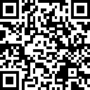
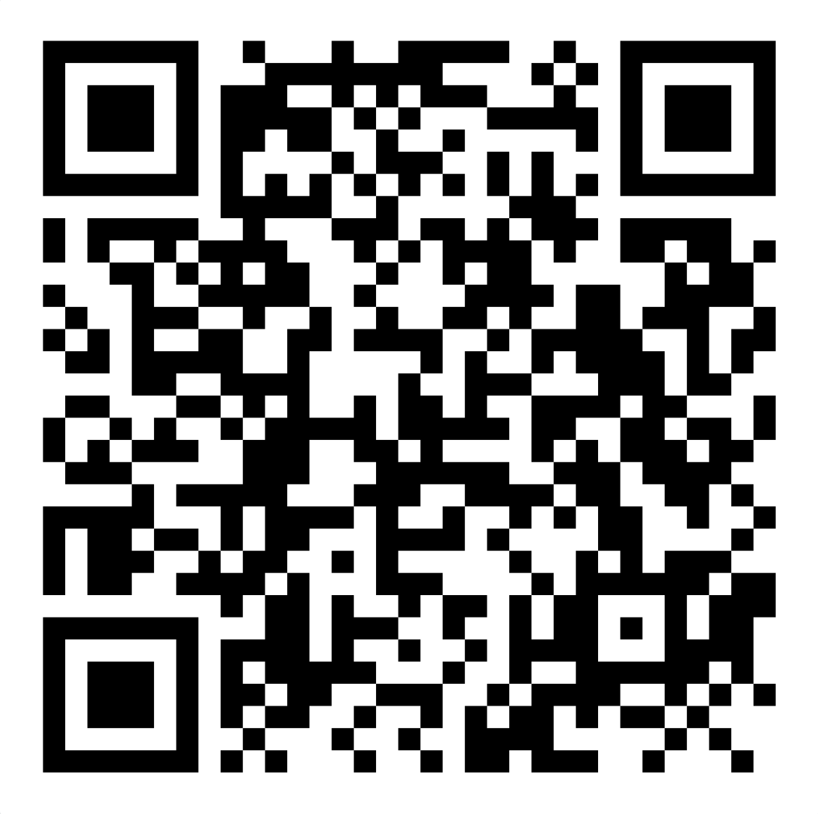
Seventh Tradition
Our seventh tradition states that every group ought to be fully self-supporting, declining outside contributions
To make a contribution to the World Region (www.nar-anon.org/contribute-to-nar-anon):
To make a contribution to the Local Region (https://www.naranonrm.org/donate and click “Donate”):

Slide 18
30 seconds remaining

Slide 19
Please wrap up your share

Slide 20
Serenity Prayer (we)
God, grant us the serenity to accept
the things we cannot change,
the courage to change the things we can,
and the wisdom to know the difference

Slide 21
Serenity Prayer (me)
God, grant me the serenity to accept
the people I cannot change,
the courage to change the One I can,
and the wisdom to know it’s Me

Slide 22
Third Step Prayer
Higher Power,
Guide me on my journey to peace and serenity
Help me to let go of self will
and turn my life over to your care.

Slide 23
Prayer for the Growth of Our Fellowship
God, we thank you for the peace and serenity we are finding as we learn to put our addicts in Your hands, one day at a time, and cease trying to change them. We are grateful that You helped us to find our way here, and we ask that You help those still alone and in pain because of the addiction of a friend or loved one. Please help them to find their way to these rooms, so that we may give back the gifts we have been so freely given, as well as give us a chance to share our experience, strength, and hope with those suffering the isolation created by living with an addict. As we try to reach out to others with our fellowship, help us to be ever mindful of our traditions. We are trusting in Your love and concern for our addicts and us, and we ask that You help us to search always for Your will for us and for those we care about.

Slide 24
On Friendship – Nar-Anon Style
“Oh, the comfort – the inexpressible comfort
of feeling safe with a person –
having neither to weigh thoughts nor measure words,
but pouring them all right out
just as they are, chaff and grain together
certain that a faithful hand will take and sift them.
keep what is worth keeping,
and then with the breath of kindness, blow the rest away.”
- Dinah Craik, A Life for a Life, 1859

Slide 25
Look To This Day
(The Twenty-Four-Hour Program)
Look to this day!
For it is life, the very life of life.
In its brief course lie all the verities
and realities of your existence.
The bliss of growth,
The glory of action,
The splendor of beauty
For yesterday is but a dream
And tomorrow only a vision;
But today well-lived, makes
Every yesterday a dream of happiness,
And every tomorrow a vision of hope.
Look well, therefore, to this day;
Such is the salutation of the dawn!

